Slide 1
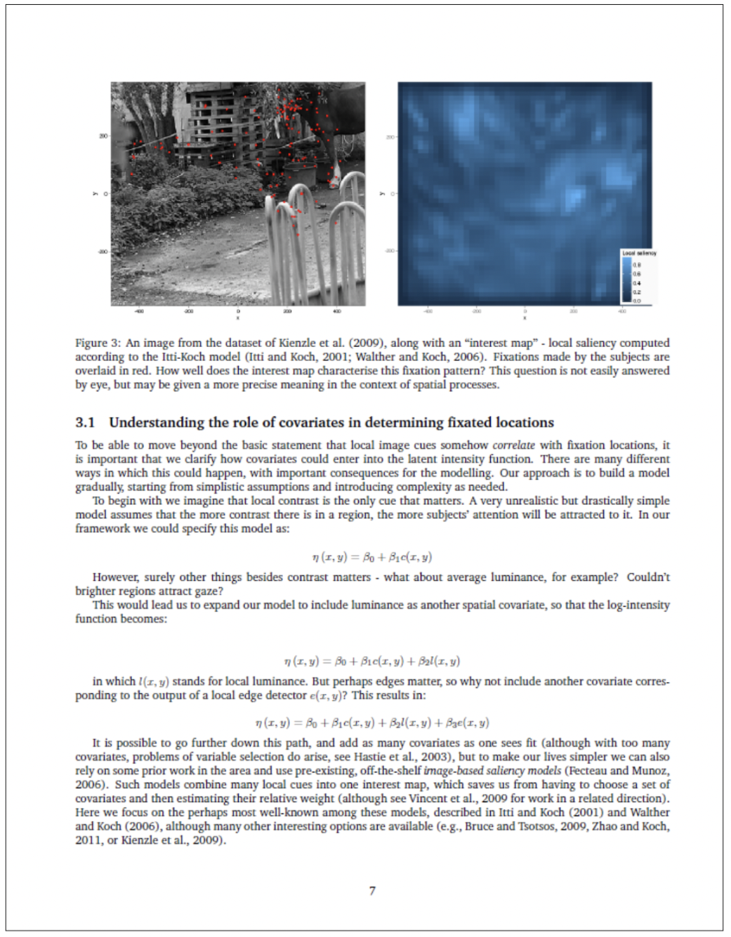
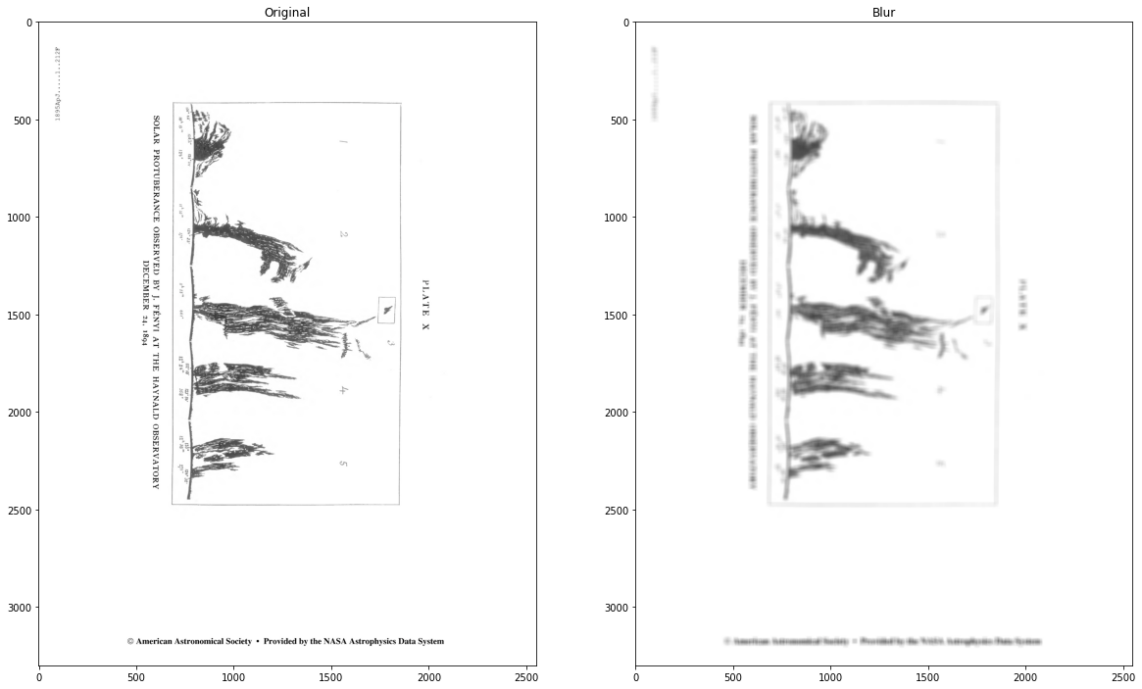
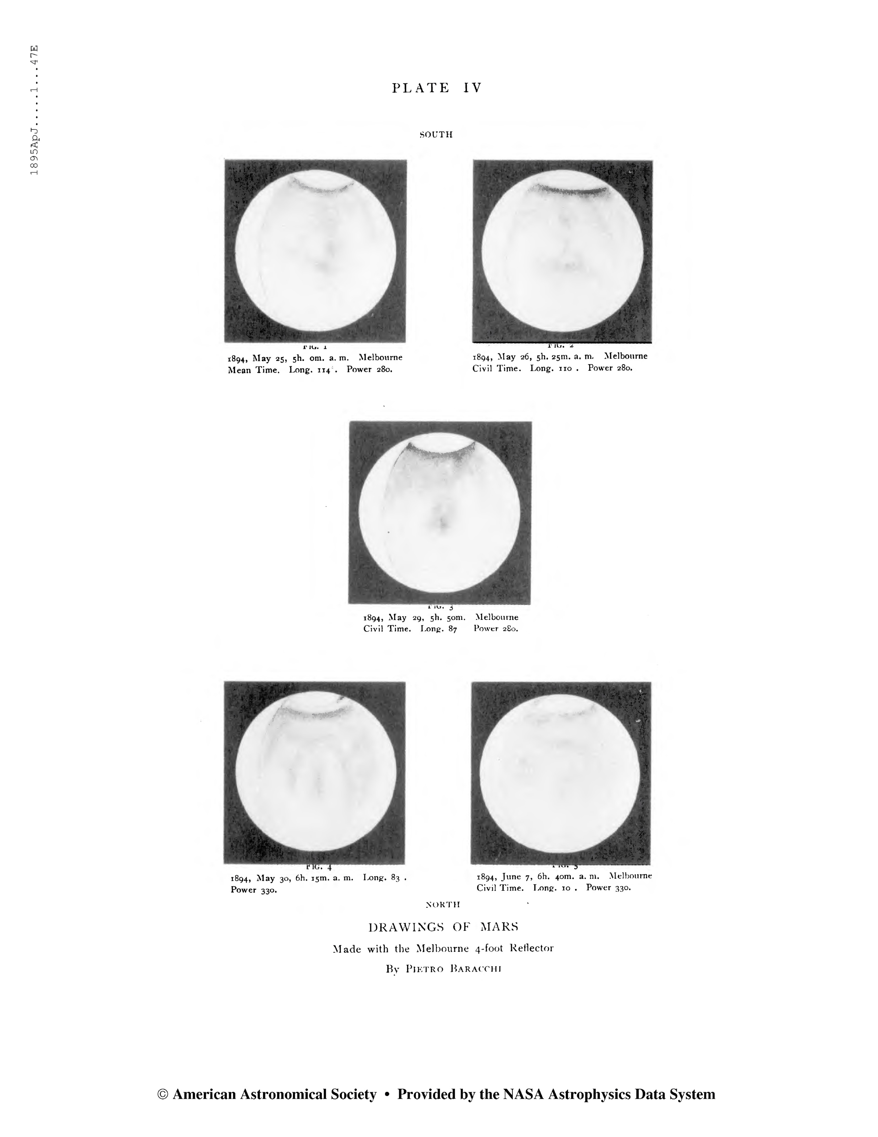
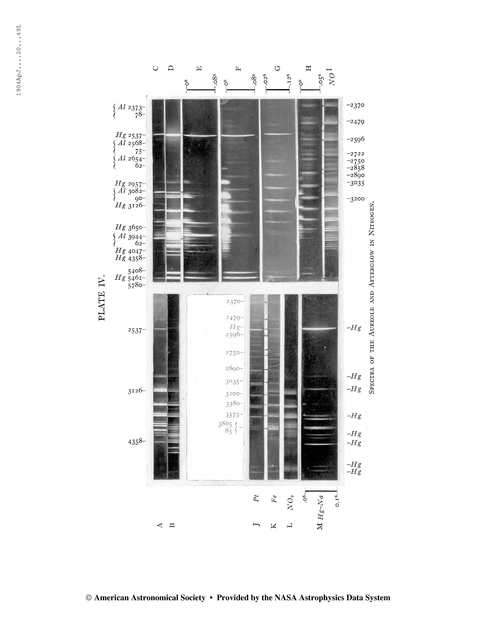
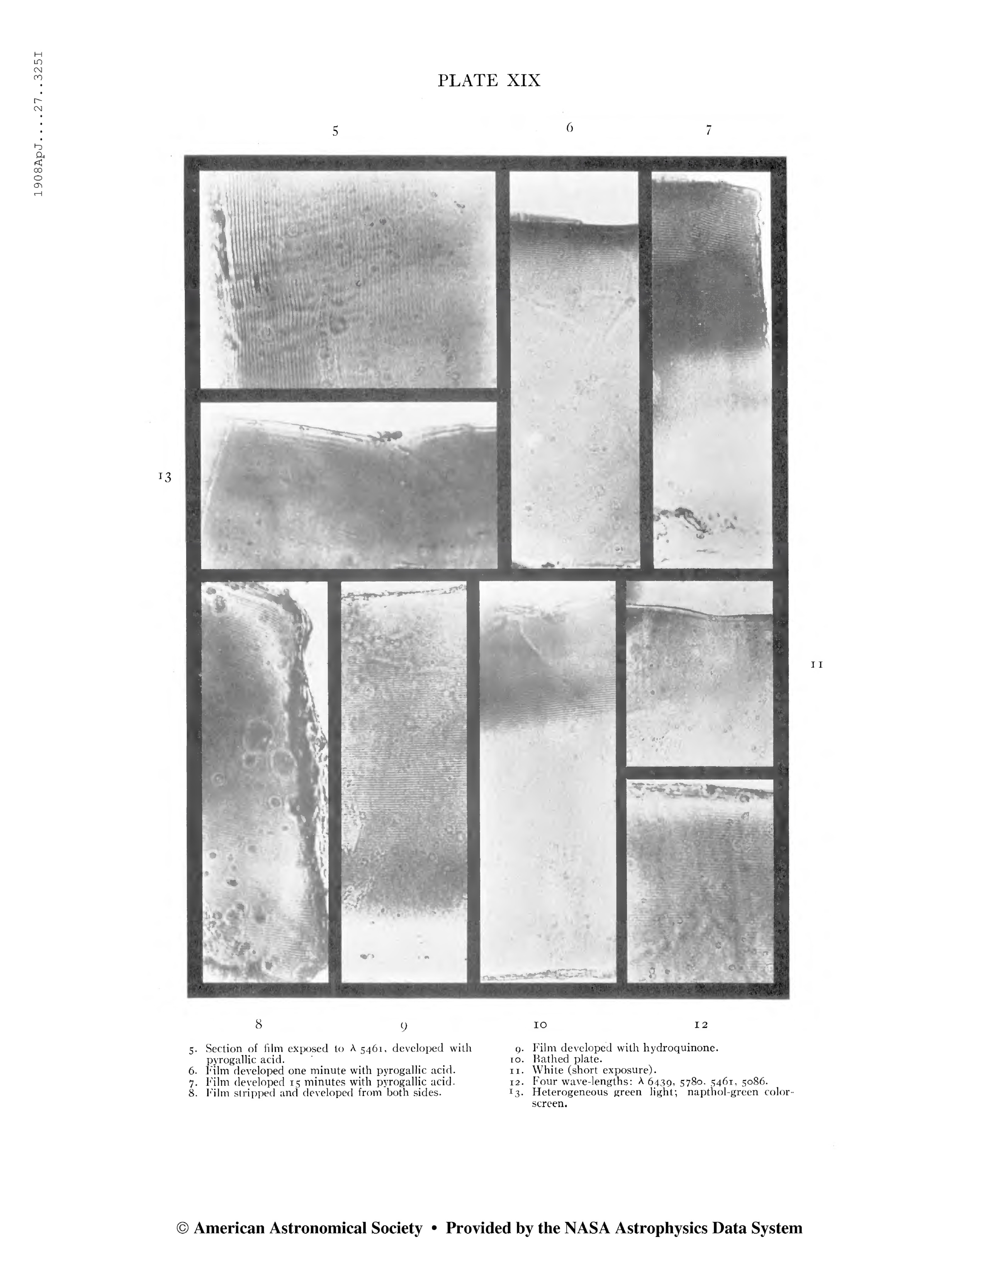
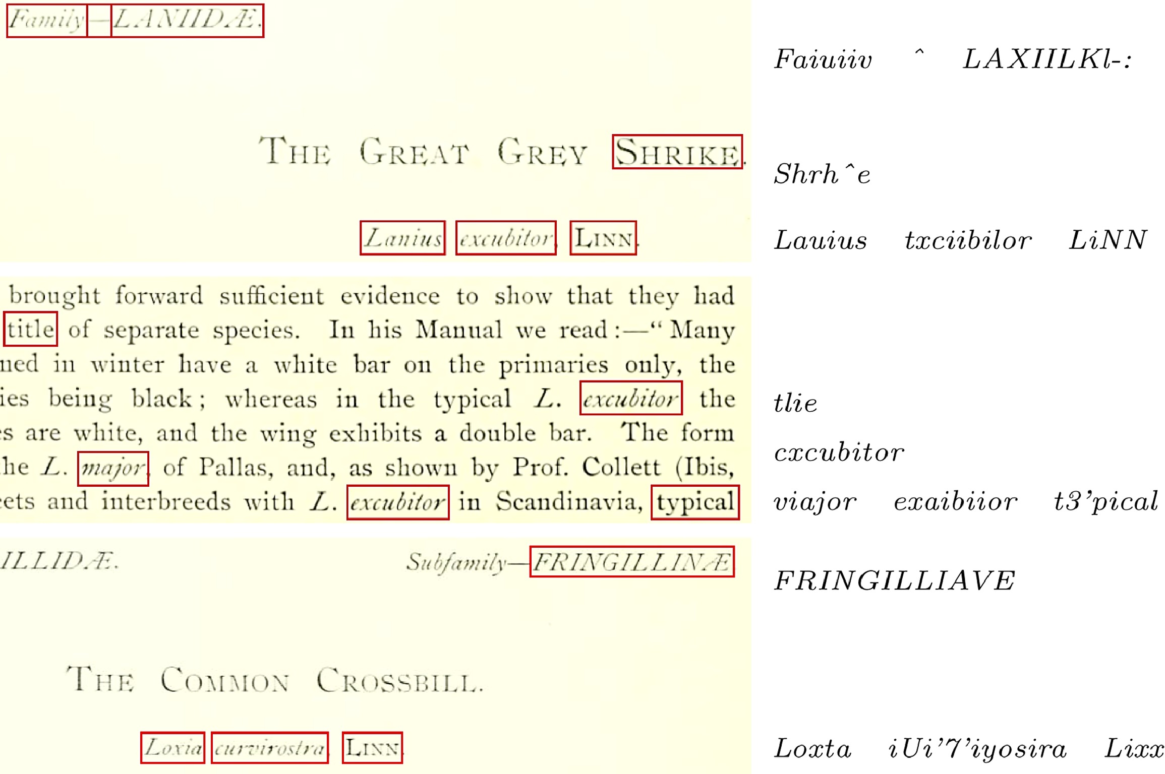
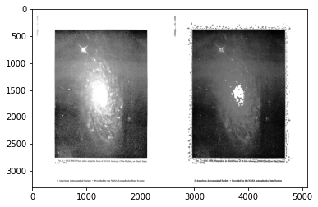
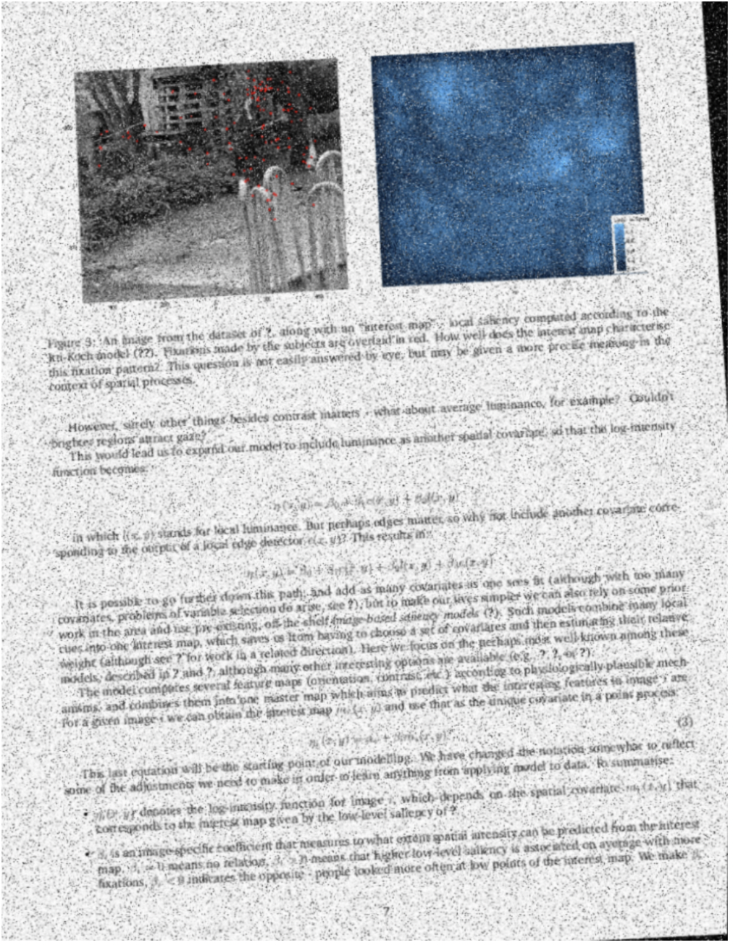
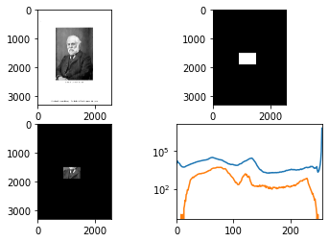


Cleaning Optical Character Recognition with Image Processing: Document Aging and Revitalizing
Rushdan Jimoh, Dr. Jill Naiman School of Information Science, University of Illinois at Urbana-Champaign
INTRODUCTION
Optical Character Recognition (OCR) is the process where scanned images can be converted into machine- readable text. For this project, we’ll be using images like these that are from NASA’s Astrophysics Data System which has millions more images
Why is this important? OCR isn’t as accurate as it could be due to many reasons such as aging of the pages.
METHODS
To further our investigation, we wanted to ask ourselves, “what makes images look old?”
Figure 3 & Figure 4. Kahu, S. Y., Ingram, W. A., Fox, E. A., & Wu, J. (2021). ScanBank: A benchmark dataset for figure extraction from scanned electronic theses and dissertations. 2021 ACM/IEEE Joint Conference on Digital Libraries (JCDL). https://doi.org/10.1109/jcdl52503.2021.00030
This example image below shows several aging transformations conducted on the above image. The following were some of the transformations that were performed:
Font
Line Spacing between lines, words, and letters
Noise was added to the page
Blur
Rotated Page
Figure 4. Kahu, S. Y., Ingram, W. A., Fox, E. A., & Wu, J. (2021). ScanBank: A benchmark dataset for figure extraction from scanned electronic theses and dissertations. 2021 ACM/IEEE Joint Conference on Digital Libraries (JCDL). https://doi.org/10.1109/jcdl52503.2021.00030
RESULTS
The images below show the result of some of the things that can be done throughout this process
Adding Blur to an image
Using Contrast in an image takes the quality away from an image to better us in the “aging” of pages
Finding the color distribution of a particular section of the page
By looking at the distribution of colors in different parts of the page, we can quantify the differences between the distributions of old vs. new pages (Blue line = full image distribution, Orange line = masked area distribution)
CONCLUSIONS
This research explored ways to artificially “age” article pages to create “fake” historical documents for further processing and to create artificial training data for machine learning models
FUTURE WORK
Moving forward, we will be creating “fake” historical training data for the Tesseract OCR engine by artificially aging newer articles (where “ground truth” text can be extracted”)
We will find out how to better un-age old scanned images before they are OCR’d
ACKNOWLEDGEMENTS
I would like to give my appreciation to Dr. Jill Naiman for being an excellent mentor, along with the SPIN program for allowing me to be apart of this amazing summer experience.
CITATIONS
- Kahu, S. Y., Ingram, W. A., Fox, E. A., & Wu, J. (2021, June 23). ScanBank: A benchmark dataset for figure extraction from scanned electronic theses and dissertations. arXiv.org. Retrieved June 20, 2022, from
https://doi.org/10.48550/arXiv.2106.15320
- Goodman, A. (1970, January 1). The ADS all sky survey. NASA/ADS. Retrieved June 20, 2022, from https://ui.adsabs.harvard.edu/abs/2011adap.prop..111G/abstract
- L. D. Lopez, J. Yu, C. N. Arighi, H. Huang, H. Shatkay, and C. Wu, “An automatic system for extracting figures and captions in biomedical pdf documents,” in 2011 IEEE International Conference on Bioinformatics and Biomedicine, pp. 578–581, 2011.
- P. Li, X. Jiang, and H. Shatkay, “Figure and caption extraction from biomedical documents,” Bioinformatics, vol. 35, pp. 4381–4388, 04 2019. https://www.oreilly.com/library/view/hands-on-machine-learning/9781491962282/
- Williams, S. (2019, March 27). Digital Collections OCR: What it is, and what it isn't. DigitalNC. Retrieved July 13, 2022, from https://www.digitalnc.org/blog/digital-collections-ocr-what-it-is-and-what-it-isnt/
AIM
What is the goal?
The goal of this project is to understand the processes which degrade historical page scans and increase OCR error rates
- This will, in turn, make the text from historical articles easier to index and catalog for future research

